Slide 1
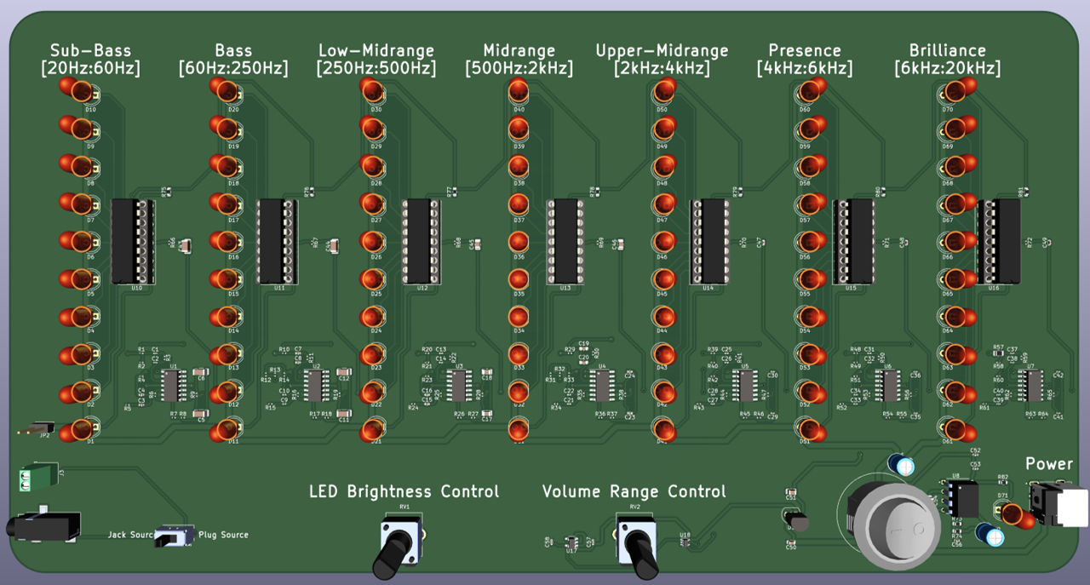
Electronic Design Project: Audio Visualizer
Ghani Lawal

Slide 2
Background
Completed Bachelor’s and Masters in Electrical and Computer Engineering at Queen’s University
Held position as the master’s student representative in internal student council
Relevant courses: Electronics, Embedded Systems, Sensors and Actuators, Control Systems, Electric Machines, Robotics and Signal Processing
Experience working in multidisciplinary design teams and group projects
Artificial intelligence and Embedded systems team member of Queen’s RoboKnights
Compete in competitions hosted by DJI
Previous projects: Adaptive Grip Pick and Place Robot, Remote Control Differential Drive Robot, Audio Visualizer
Proven proficiency with microcontrollers, circuit design, C/C++, MATLAB, Altium CircuitMaker, KiCAD, LTSpice and control systems
Enjoy playing chess, badminton, sketching

Slide 3
Purpose & Research
Purpose:
Go through the entire electronic design process, from inception to a finished working prototype
Build a fully analog and/or digital circuit product, avoid relying on microprocessors/microcontrollers
Develop a system indicates which frequency spectrums an audio signal is composed of
Research:
Humans can hear frequencies between 20 Hz and 20kHz – divided into 7 frequency spectrums
Sound is measured in dB, a 10 increase in amplitude is perceived as doubling in volume

Slide 4
Functional Requirements
Separate audio signal into its frequency spectrum components: Sub-Bass, Bass, Lower Midrange, Midrange, Upper Midrange, Presence and Brilliance
Display value of each frequency spectrum on a dB scale using LEDs
Control the magnitude range that is displayed
Control the brightness of the LEDs

Slide 5
Functional Sub-Circuit Dev: Spectrum Filter
Active Butterworth filter – maximally flat passband
Can easily cascade without worrying about loss in magnitude
Designed using Analog Devices filter wizard, verified with LTSpice
Used 3 stage, 6th order filters for all spectrums
Attenuates signal at $≈$70 dB/decade

Slide 6
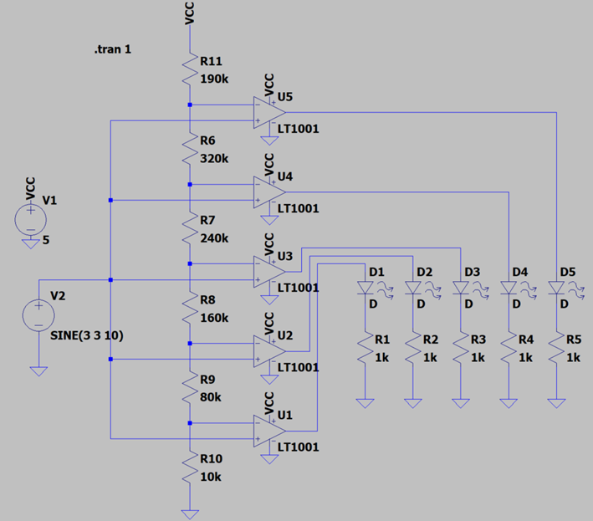
Functional Sub-Circuit: LED Display driver
Originally planned to used comparator array
Found LED Driver IC – LM3915
Displays amplitude on a log scale
Can adjust LED brightness
Will take up less board space

Slide 7
Functional Sub-Circuit Dev: Spectrum Filter Sourcing and Testing
Operation amplifier IC LM324:
4 op amps per IC
Requires dual rail power supply, 1.2 mA supply current per IC
Re-simulated with LM324 and closely matched resistors
Avoided using parallel/series combinations to save cost and board space
Implemented resistor values within 1.2% of ideal resistor value

Slide 8
Functional Sub-Circuit Dev: LED Driver Sourcing and Testing
IC no longer manufactured, bought on eBay
Used tone generator website to test LED output against different frequencies
Noticeable flickering below 40 Hz
Considered adding full wave precision rectifiers – deemed unnecessary

Slide 9
Circuit Non-Idealities
LED Driver LM3915 signal port issues:
Has a floating voltage of 0.13V
Outputs $≈$130nA when connected to a pulldown resistor
Op-amp IC LM324 issue:
Maximum input offset voltage of 7mV
Why this is a problem:
Voltage when audio signal is set to 100% on laptop was 800mV
Voltage when audio signal is set to 42% (maximum safe level) was 173mV
LED Driver displays values down to -30 dB, approximately 4% of reference voltage

Slide 10
Input offset voltage and Current Leak Issues - Solution
Considered using high precision op amp, however:
When input offset voltage $≤$100uV, IC only contains 1 or 2 op amps
Least expensive IC on Mouser was $0.662 for a dual channel
Solution: append high pass RC filter to output of spectrum filters, R = 1kohm
Vsig $≤$ 0.140 mV
Sub-Bass and Bass: C = 100uF
Low-Mid and Mid: C = 10uF
Upper-Mid, Presence and Brilliance: C = 1uF

Slide 11
Max Current Output of Filter Stages

Slide 12
Non-Functional Requirements
Entire circuit is to be powered by a 9V AC Adapter
LED driver operates on single supply up to 25V
Op-amp ICs to be powered by +/- 5V DC
Input port can accept signals up to within 1.5V of the power supply
Max voltage from laptop determined to be 800mV, no chance of clipping the input signal
LED driver can properly measure signals up to within 1.5V of power supply
Maximum Dimensions: 300 mm x 200 mm (or 11.8” x 7.9”)

Slide 13
Dual Rail Power Supply
Originally planned to use dual rail voltage regulator IC such as LT1026
Expensive: $10/chip
Max output current of 15 mA
Generated +5V with MC78L05
Generated -5V with LT1054IPE4
Both can output up to 100 mA

Slide 14
Functional Sub-Circuit: Brightness Control of LEDs
Brightness of an LED varies logarithmically with the current passing through it
LEDs rated for 20mA, set circuit so that maximum current is 17.53mA using 680 ohm resistor
Current controlled by REF port, current flowing through LED is 10x greater than current flowing through this port
Log potentiometer used to control LED current of all drivers

Slide 15
Functional Sub-Circuit: VOLTAGE MAGNUTIDE REFERENCE CONTROL
According to datasheet, resistance between $R_{hi}$ and $R_{lo}$ typically 22k
Average value of resistance across all the drivers was 17.5kom
Approximate equivalent resistance is be 2.5k ohm
Log potentiometer appended with voltage buffer use to control $V_{Rhi}$

Slide 16
PCB View

Slide 17
3D Model View

Slide 18
Design Review
Add stitching vias to the ground pour
Don't daisy chain the power connections, use star formation
Be mindful of physical construction of the plugs
Move decoupling capacitors closer to the IC it is associated with
Add 0.1uF capacitors to power pins of op-amps
J2 (DC power jack) should have reverse voltage protection
Add high impedance input buffer to filter section to avoid unnecessary loading could use extra op amp in each filter section as the buffer

Slide 19
Results
Frequency spectrum filters attenuate signals at 67 to 90 dB per decade
LED current limits: 180uA to 17.53mA
Reference voltage magnitude range: 10uV to 3.5V
Power supply voltages: +9V, +5V, -5V
Standby current: 33 mA
Trace widths: 50 mils (power), 20 mils (power), 10 mils (signal)
Final board size: 295mm x 155mm (or 11.6” x 6.1”)

Slide 20
Project Links
GitHub: https://github.com/GhanGhan/Music_Visualizer
Hackaday: https://hackaday.io/project/184570-music-spectrum-and-db-visualizer

